Slide 1

UNIX - Fundamentals
7
Simple Filters
9
SED
5
The shell
cmp comm diff head and tail …
Inserting
Updating
Deleting
RegEx….
1
UNIX Intro
3
Unix File System
Pattern matching
Escaping Redirecting…
The UNIX OS
The Linux OS
Features of Unix
The file
pwd and cd
mkdir
ls and cp ..
Shell Programming
8
GREP
10
6
The Processes
The character class
The *
The Dot…
condition eval
loops
read
exit status
4
Vi/Vim editors
ps nohup at and batch
2
Unix Commands
Input mode
Saving text
Aborting…
command basics
man
echo
printf …
Biz Nigatu
Software Engineer and Instructor
reckonedforce.com
@bizNigatu

Slide 2
Section 3 – UNIX Fundamentals
listing files and directories
file permissions
chmod (relative, absolute and recursive -R)
file and directory permissions (read, write, execute)
umask (default permissions)
Inodes
ln (links)
chown and chgrp commands (changing ownership and group)
last update time
find command (!,-o and -a)

Slide 3
Chapter 4 – *** File Attributes

Slide 4
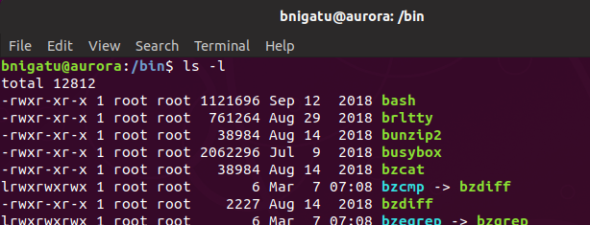
‘ls’ with File Attributes
(-l): Listing File Attributes
The output of ‘ls –l’ command often referred to as the listing, and it contains Type and Permissions, Links, Ownership and Group Ownership, Size, Last Modification Time, Filename.

Slide 5
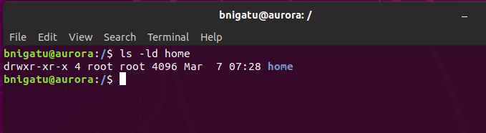
ls with File Attributes (continued)
(-ld): Listing Directory Attributes
To see the attributes of a directory home rather than the filenames it contains, use ls -ld home
This won’t show the listing of all subdirectories in the current directory.

Slide 6
Permissions
Unix/Linux utilizes a three-tiered file protection system that determines access rights
All attributes, except filename, are stored in the inode (Unix/Linux file control block (FCB))
The second, numeric, field shows the number of links
Directories have a link number of at least two
The permissions for owner (user), group, and others (world) are: read (r), write (w), and execute (x)
-rwxr-xr-- means the owner has read, write, execute permission, the group has read, execute permission, and Others have read permission
EVERY file has an owner
Kernel allocates space in blocks of 1024 or, more commonly, 4096 bytes, thus, a file of 200 bytes will still occupy 4096 space

Slide 7
Classes of Users
In Unix and Linux, there are three classes of users
Owners (symbol u)
Group (symbol g)
Others (or World; symbol o)
Symbol a = all, e.g. ugo
Each class has three permissions
Read
Write
Execute

Slide 8
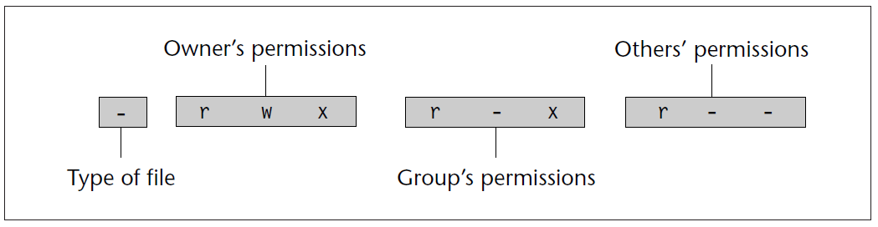
File Attributes
‘ls –l’ (for long list) displays a file’s attributes
File attributes are broken down into 4 categories:
Others’ is also known as ‘world’
Type of file are: d = directory, l = soft link, - = ordinary file
Structure of a File’s Permissions String

Slide 9
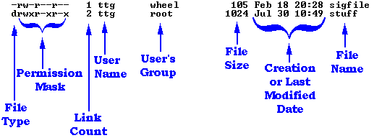

chmod
Relative Permissions: When changing permissions in a relative manner, chmod only changes the permissions
specified in mode and leaves the other permissions unchanged.
Absolute Assignment: The = operator can perform a limited form of absolute assignment.
chmod –R: descends a directory hierarchy and applies the expression to every file and subdirectory it finds in the tree-walk: chmod -R a+x shell_scripts

Slide 10
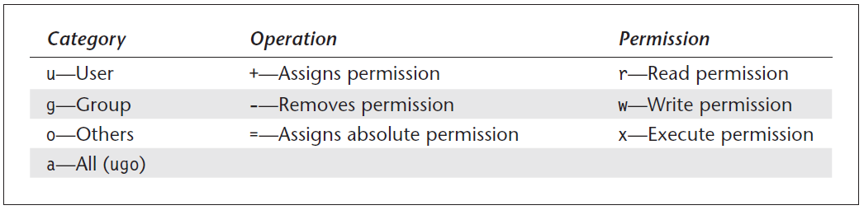
chmod (continued)
Syntax: chmod [–R] mode file
Example:
chmod u-x,go+r date.sh ls -l date.sh chmod ugo=r date.sh chmod a=r date.sh
This technique has its limitations; you can’t just set all nine permission bits explicitly

Slide 11
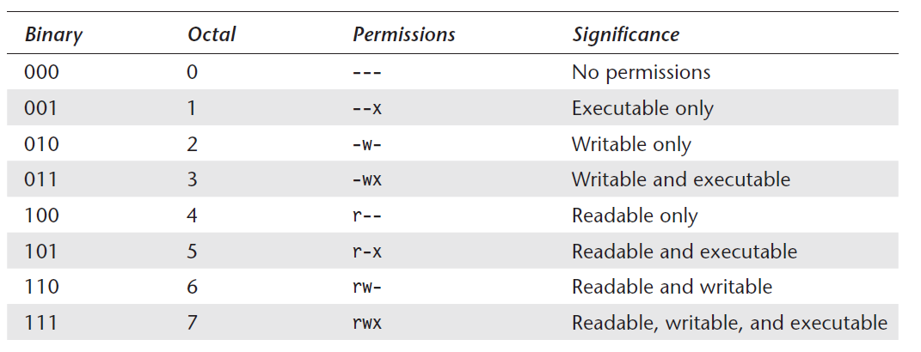
chmod (continued)
Octal numbers use the base 8, and octal digits have the values 0 to 7. This means that a set of three bits can represent one octal digit.
For example, Read permission—4 (Octal 100), Write permission—2 (Octal 010), and Execute permission—1 (Octal 001)

Slide 12
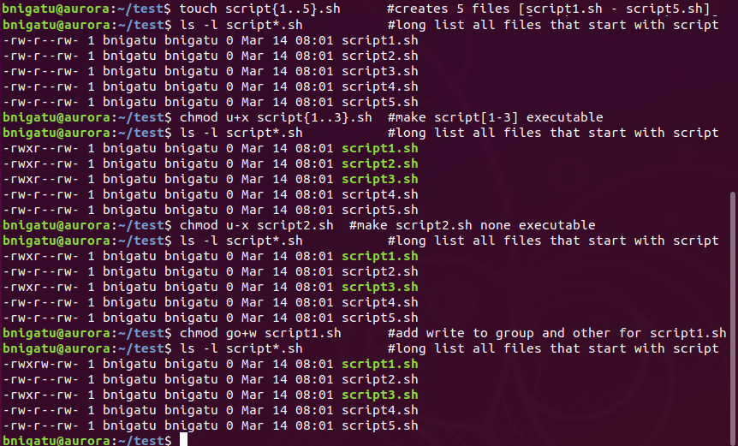
chmod Examples

Slide 13
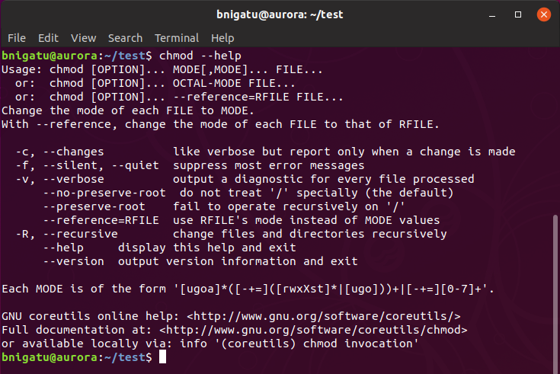
chmod Help

Slide 14
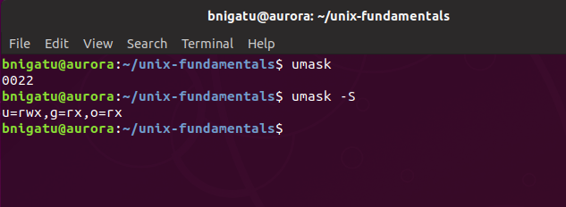
umask
Files and directories are created based upon a default set of Unix permissions determined by the umask setting
0002 = 002 (will be explained shortly)
To view symbolically, enter ‘umask –S’

Slide 15
umask (continued)
As noted earlier, the three categories are:
Owners or users (u)
Group (g)
Others (o)
All (a)
To give write permission to the group you would ‘umask g+w’
‘umask u-x,g=r,o+w’ =
Remove execute from user but keep other permissions
Give read to group only (no write or execute)
Give write to others in addition to any other permissions

Slide 16
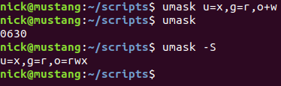
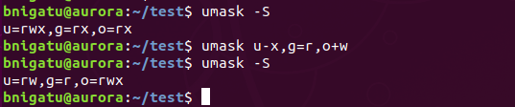
umask (continued)
Example:
‘umask a=‘ will set the file creation mask so that new files are inaccessible to everyone. The ‘=‘ sign means prohibit any permission not specifically stated

Slide 17
umask Representation
The symbolic permission of rwxr-xr-- would be represented using the three-digit octal number 754
The order of the digits is always the same: User, Group, Other
In octal representations of file permissions, there are actually four digits
The three important digits are the last three digits
The first digit is a special file permission indicator, and can be considered always to be zero
Thus, file permission 777, may be referred to as 0777

Slide 18
umask in Action
The umask masks permissions by restricting them by a certain value
Essentially, each digit of the umask is "subtracted" from the OS's default value to arrive at the default value that you define
The result is that the umask tells the operating system which permission bits to "turn off" when it creates a file
It's not really subtraction
In Linux, the default permissions value is 666 (rw) for a regular file, and 777 (rwx) for a directory
When creating a new file or directory, the kernel takes this default value, "subtracts" the umask value, and gives the new file(s) the resulting permissions

Slide 19
umask in Action (continued)
Using the Linux default value of 666 (rw) for NEW files:
umask u+x would change the umask value to 766
umask a=x would change the umask value to 111
umask o-w would change the umask value to 664
umask a= would do what?

Slide 20
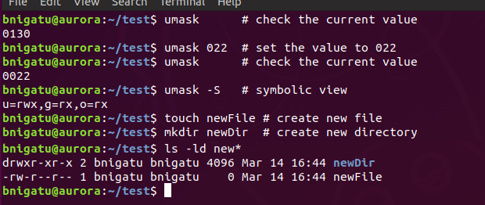
umask in Action (continued)
if umask value is 022, then any new files will, by default, have the permissions 644 (666 - 022)
Likewise, any new directories will, by default, be created with the permissions 755 (777 - 022)
755
644

Slide 21
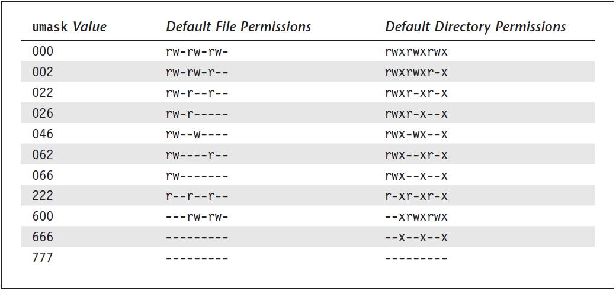
umask Table
Effect of umask Settings on Default Permissions

Slide 22
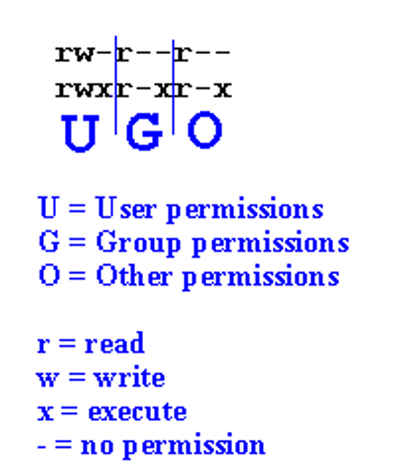

Permissions Mask
First 3 bytes - User
The user owns the file
r (read)
w (write)
x (execute)
- permission denied
2nd 3 bytes - Group
3rd 3 bytes - Other

Slide 23
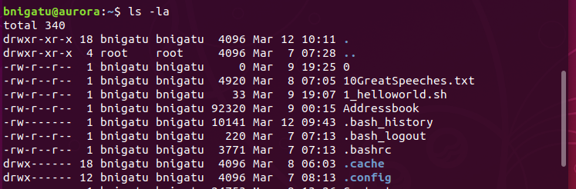
Dotted Files
A filename that starts with a dot is called a dotted file, a hidden or protected file
dotted files are exempt from file matching metacharacter expansion
To see dotted files, use the -a (all) option on the ls command
Example:

Slide 24
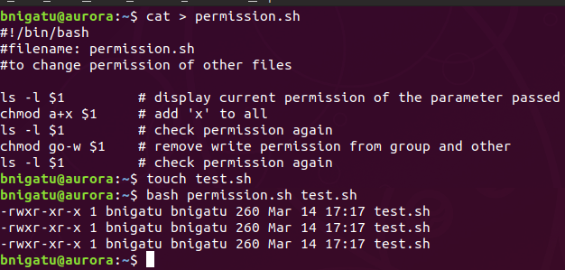
Sample shell script for permission change
Using shell script to change file permissions

Slide 25
chmod in Ubuntu
While there is no requirement to put a ‘.sh’ at the end of a script, it does make it easier to identify your scripts
If you put your scripts in /bin
If you put your scripts in /scripts, then .sh is not necessary
Once you create a script, you will need to ‘chmod u+x <filename>’ in order to run it
chmod –R will recursively descend a directory hierarchy and apply the expression to every file and subdirectory it finds in the tree-walk:
‘chmod –R u+x *’ : make all scripts executable by user
‘chmod –R a+r class’ : class is a directory so make everything read by everyone

Slide 26
Inode
Before getting into the term Symbolic link and Hard link ,lets understand the term ‘inode’ . A Unix file is “stored” in two different parts of the disk — the data blocks and the inodes. The data blocks contain the “contents” of the file. But the information about the file is stored elsewhere — in the inode. Basically, inode is a file structure on a file system. More easily, it is a “database” of all file information except the file contents and the file name. Both the inodes and data blocks are stored in a “filesystem” which is how a disk partition is organized.
Source: Mohan, M. (2017, February 07). Hard Link and Symbolic Link?? Retrieved from https://medium.com/@meghamohan/hard-link-and-symbolic-link-3cad74e5b5dc

Slide 27
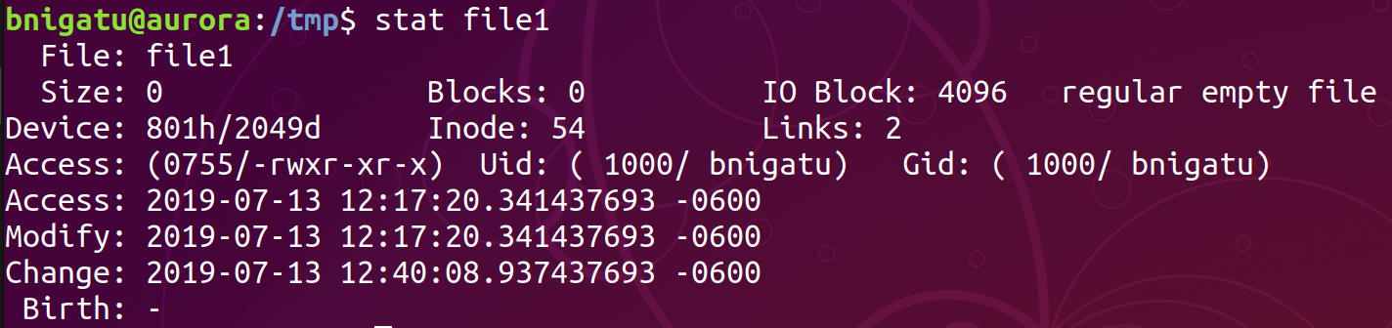
Display Inode
To display the inode number of a file use ‘ls –i’ command
To display detail attributes of a file inode use ‘stat’ command

Slide 28
Hard and Soft Links
Why is filename not stored in inode? So that a file can have multiple filenames
When that happens, the file has more than one link
The file can be accessed by any of the links
To create a link, use the ‘ln’ command
‘ln’ can be used to create both hard and soft links

Slide 29
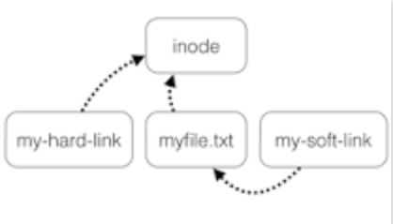
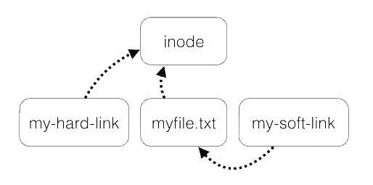
Hard and Soft Links
A hard link just creates another file with a link to the same underlying inode. When you delete a file, it removes one link to the underlying inode. The inode is only deleted (or deletable/ over-writable) when all links to the inode have been deleted.
Soft links (symbolic) point to the a file but are separate files themselves. Think of a template that everyone uses
inode
my-hard-link
myfile.txt
my-soft-link

Slide 30

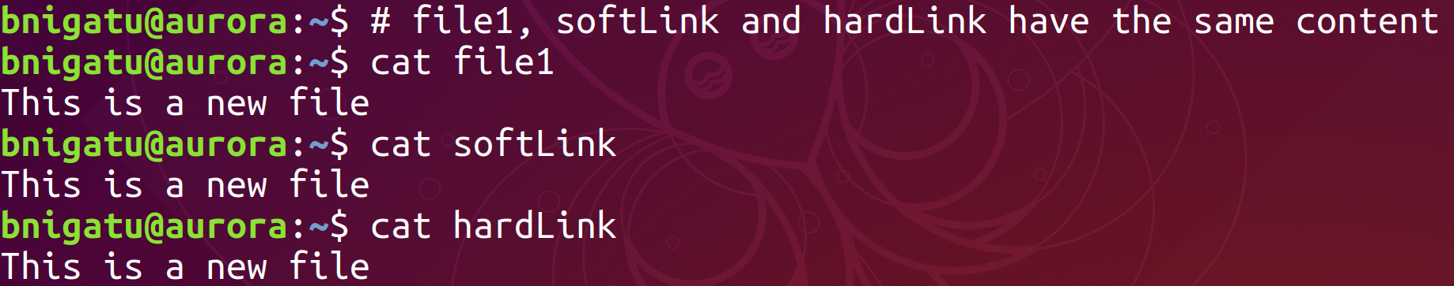
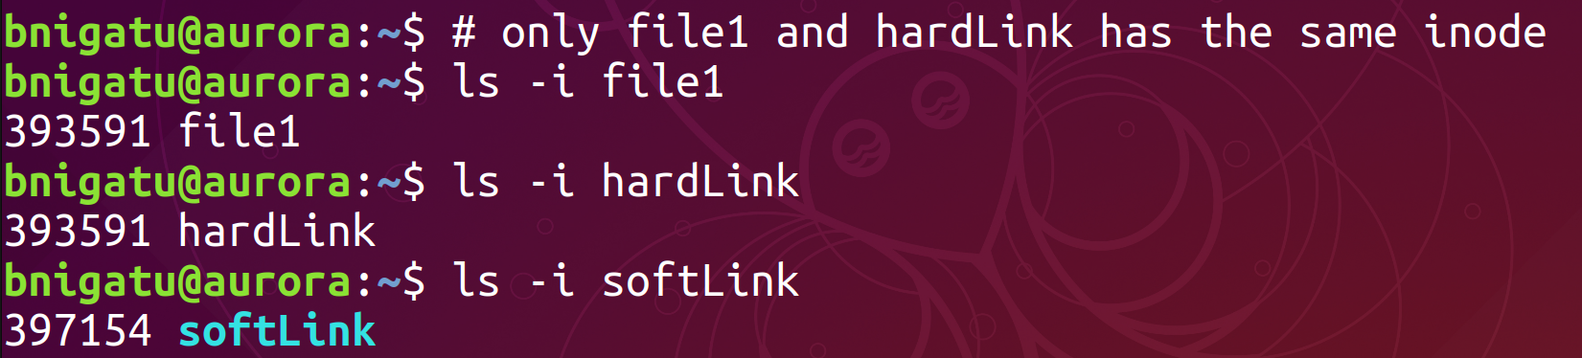
Hard/Soft Link Example

Slide 31
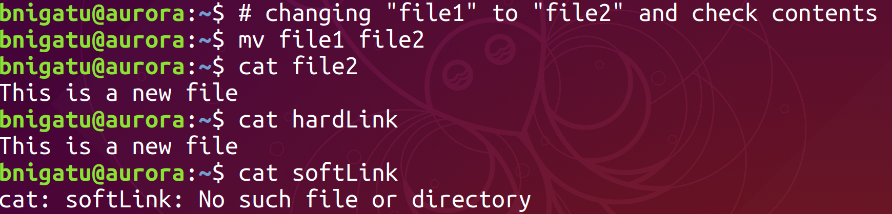
Hard/Soft Link Example
Change the name of file1 and printout hardLink – no change due to the hard link:
This is because hardLink points to the inode, the contents, of the file - that wasn't changed
A hardLink isn't a pointer to a file, it's a directory entry (a file) pointing to the same inode
However, incase of soft link the file could not be found because soft link points to the name, that was changed, and not to the contents

Slide 32
Display hard/soft links
To display hard and soft link use ‘ls –l’ command

Slide 33
chown: Changing File Ownership
There are two commands meant to change the ownership of a file or directory—chown and chgrp. UNIX systems differ in the way they restrict the usage of these two commands.
On BSD-based systems, only the system administrator can change a file’s owner with chown. On the same systems, the restrictions are less severe when it comes to changing groups with chgrp.

Slide 34
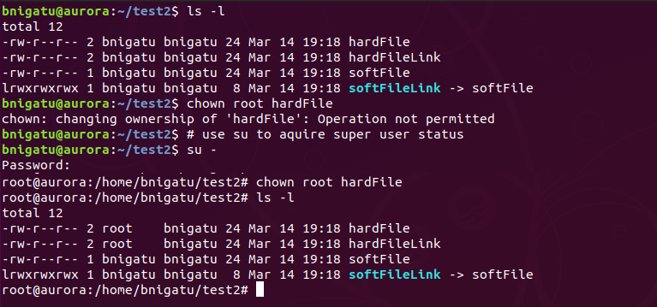
chown - Example

Slide 35
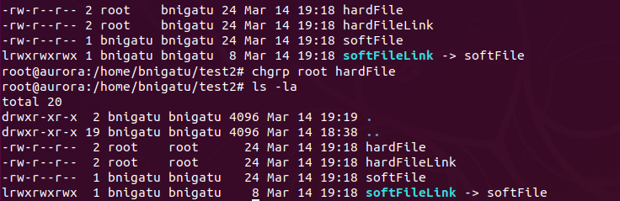
chgrp: Changing Group Owner
By default, the group owner of a file is the group to which the owner belongs. The chgrp (change group) command changes a file’s group owner. On systems that implement the
BSD version of chgrp (like Solaris and Linux), a user can change the group owner of a file, but only to a group to which she also belongs.
Before
After

Slide 36
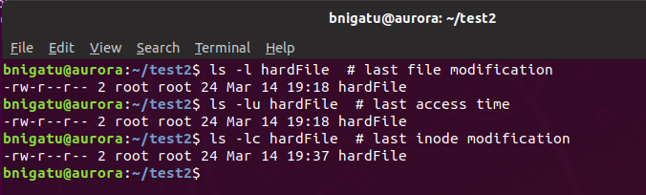
Modification and Access Times
Time of last file modification Shown by ‘ls –l’
Time of last access Shown by ‘ls –lu’
Time of last inode modification Shown by ‘ls –lc’

